Slide 1
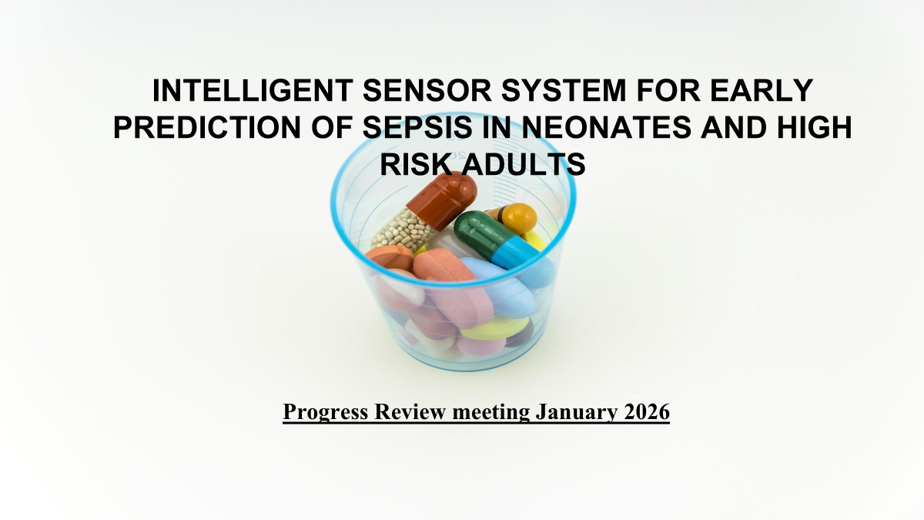

Slide 2
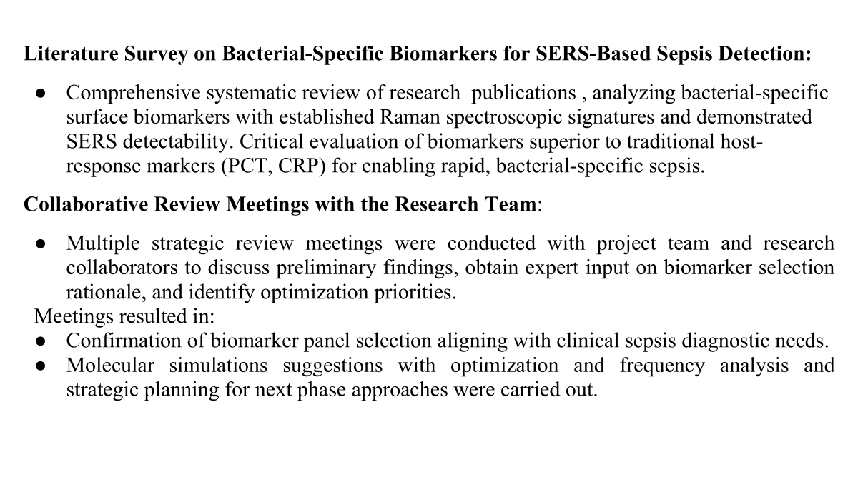

Slide 3
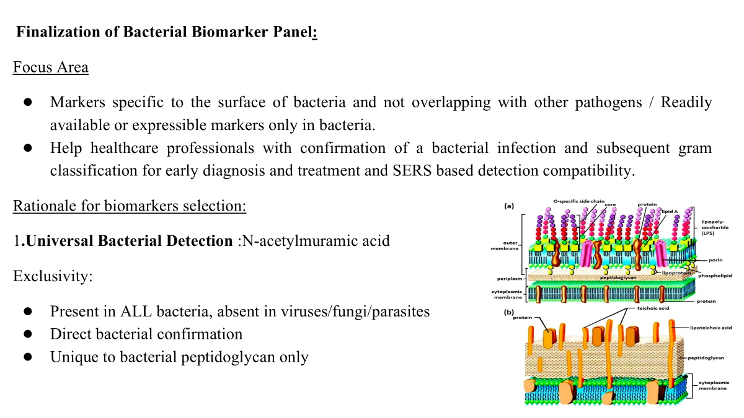

Slide 4
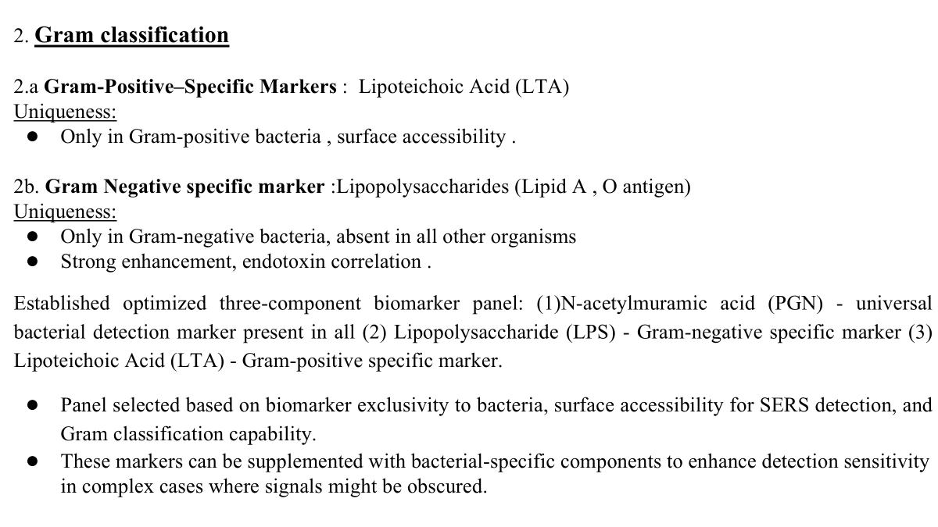

Slide 5
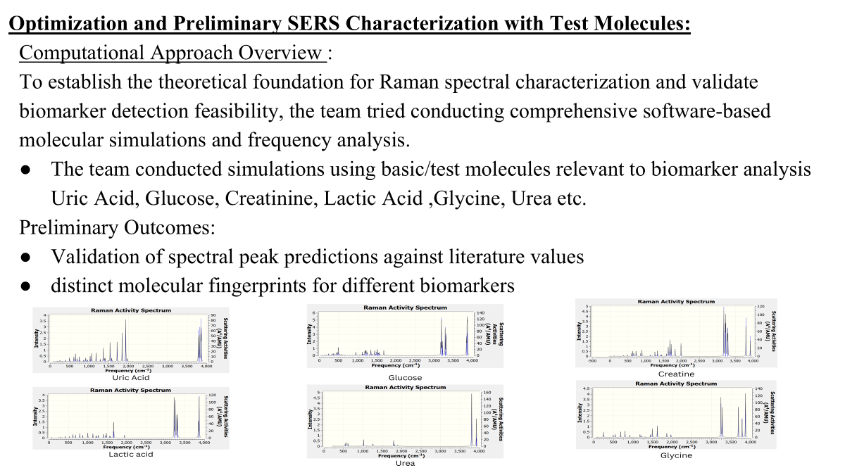

Slide 6
Initiation of Pure Biomarker Sample Procurement Procedures
Initiation of procurement procedures for commercially available high-purity bacterial biomarker standards: Trying to establish purchase with quality control specifications ensuring received biomarkers meet analytical standards for SERS characterization and clinical validation studies.​​
Planning and Strategy for Next Phase of Work
Developing comprehensive roadmap for subsequent project phases, SERS substrate optimization with pure biomarker standards, reproducibility assessment across multiple substrate batches.

Slide 7
Meetings and Review Sessions:
Collaborative Review Meetings with project team throughout December 2025
Key Discussion Points:
Strategic planning for next phase of project and translation roadmap.
Outcomes:
Following comprehensive evaluation of project requirements, analytical standards, the research team finalized minimum order quantities for all three biomarker components
MOQ (minimum order quantity) Rationale:
To ensure cost efficiency and experimental continuity, vendors were engaged for complete vials. The following quantities allow for ~100 experiments per marker.

Slide 8
Justification for MOQ:
NAM: 0.5-1 mg per experiment (100 mg = 100-200 experiments)
LPS: 0.1 mg per experiment (10 mg = 100 experiments)
LTA: 0.05 mg per experiment (5 mg = 100 experiments)
Biomarker | Supplier Form | MOQ | Unit | Est. Cost (INR)
N-Acetylmuramic Acid (NAM) | Analytical standard, lyophilized Purity: ≥98% (HPLC) | 100 | mg | ₹12,000-20,000
Lipopolysaccharide (LPS, E. coli O111:B4) | Phenol extracted, Lyophilized powder Purity: ≥90-95% | 10 | mg | ₹12,000-18,000
Lipoteichoic Acid(LTA, S. aureus, Gram-positive extract) | Purified antigen, solution/lyophilized powder Purity: >95% | 10 | mg | ₹30,000-40,000
Total MOQ Procurement | ₹54,000-78,000
Contingency (15%) | ₹12,000-20,000
Total Recommended Budget | ₹66,000-98,000

Slide 9
Order Placement and Procurement
Vendor Engagement: Successfully sourced multiple qualified suppliers through quotation process and placed order accordingly following administrative process of the institute.
Receipt of the first contingent of bacterial biomarker standards and awaiting the second one.
Literature review of optimal SERS configuration for experimental phase:
Literature review of biomarkers limits, solvents, capture probes and existing studies of NAM based on SERS technique.
comprehensive review of recent scientific literature to establish the theoretical foundation for experimental work.
The project progress represents a critical transition point from planning and preparation to active experimental work. With procurement milestones and technical preparation, the research team is looking forward to execute the planned experimental work with confidence and efficiency.

Slide 10
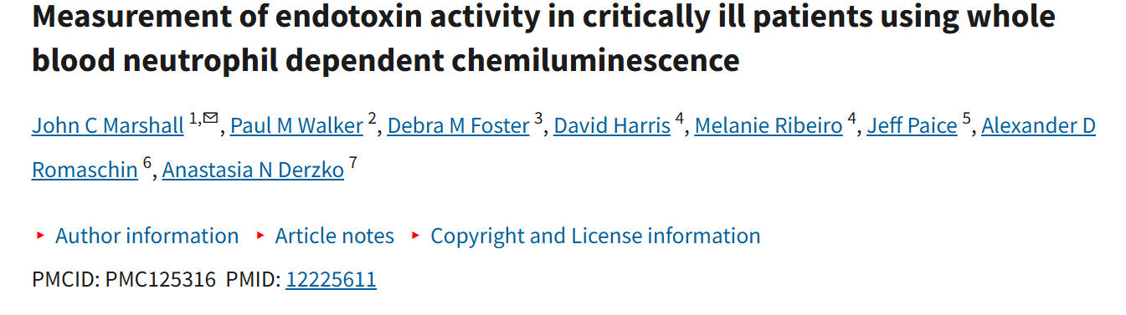
Literature Review
LPS / endotoxin
EAA outperforms LAL for clinical endotoxin detection The Endotoxin Activity Assay (EAA) enables rapid (<30 min), whole-blood detection of endotoxemia using <100 µL sample volume and shows high specificity for LPS (validated by polymyxin B inhibition), overcoming major limitations of the conventional LAL assay caused by circulating inhibitors and non-specific fungal interference.
Endotoxemia is a reliable diagnostic marker of Gram-negative sepsis All patients with culture-proven Gram-negative infections exhibited endotoxin levels >50 pg/mL (100% sensitivity in this cohort), with significantly higher levels in sepsis compared to non-sepsis patients; endotoxemia correlated with leukocytosis but not mortality, indicating strong diagnostic value rather than prognostic significance.

Slide 11
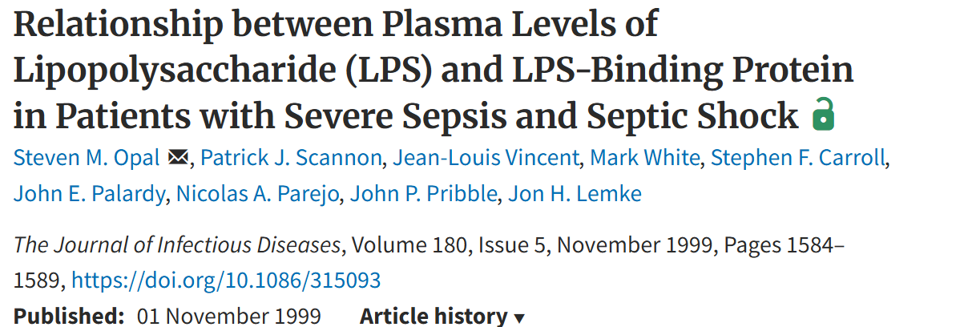
Endotoxin (LPS) levels correlate with sepsis severity and mortality Healthy: <10 pg/mL → Severe sepsis: 110–726 pg/mL (median ~300 pg/mL) → Non-survivors: ~515 pg/mL; endotoxemia present in ~78% of severe sepsis cases, with levels >50 pg/mL indicating high-risk infection and increased mortality, especially in elderly and septic shock patients.
LBP reflects host inflammatory capacity, not endotoxin burden Healthy: ~2–6 µg/mL → Sepsis: ~10–60 µg/mL (median ~31 µg/mL); survivors show higher LBP (~33 µg/mL) than non-survivors (~28 µg/mL), indicating preserved hepatic acute-phase response; LBP and endotoxin levels are uncorrelated, representing independent biological axes.

Slide 12
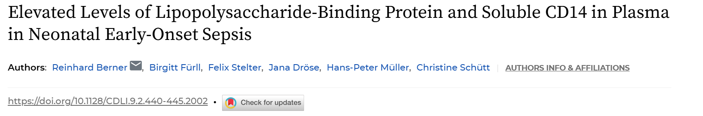
LBP and sCD14 are significantly elevated at birth in neonatal sepsis and persist beyond 24 h Septic neonates showed markedly higher plasma LBP (median 36.6 µg/mL; IQR ~10.6–50.4 µg/mL) compared to healthy controls (median 7.8 µg/mL; IQR ~6.1–10.6 µg/mL; P < 0.001), with levels further increasing at 24–48 h (median ~60 µg/mL); sCD14 was also elevated (median ~0.42 µg/mL vs 0.28 µg/mL in controls; P < 0.001) but remained stable over time.
LBP and sCD14 reflect innate immune activation independent of pathogen type Elevated LBP (~20–60 µg/mL) and sCD14 (~0.35–0.65 µg/mL) were observed regardless of blood culture positivity or Gram status (including Streptococcus agalactiae), and strongly correlated with pro-inflammatory cytokines (IL-6, IL-8, IL-1β, G-CSF), indicating activation of the neonatal innate immune response rather than Gram-negative–specific endotoxemia.

Slide 13
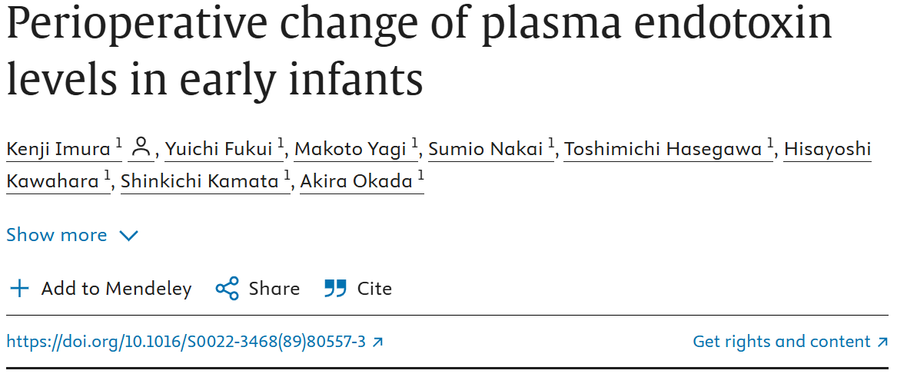
LBP and sCD14 are significantly elevated at birth in neonatal sepsis and persist beyond 24 h Septic neonates showed markedly higher plasma LBP (median 36.6 µg/mL; IQR ~10.6–50.4 µg/mL) compared to healthy controls (median 7.8 µg/mL; IQR ~6.1–10.6 µg/mL; P < 0.001), with levels further increasing at 24–48 h (median ~60 µg/mL); sCD14 was also elevated (median ~0.42 µg/mL vs 0.28 µg/mL in controls; P < 0.001) but remained stable over time.
LBP and sCD14 reflect innate immune activation independent of pathogen type Elevated LBP (~20–60 µg/mL) and sCD14 (~0.35–0.65 µg/mL) were observed regardless of blood culture positivity or Gram status (including Streptococcus agalactiae), and strongly correlated with pro-inflammatory cytokines (IL-6, IL-8, IL-1β, G-CSF), indicating activation of the neonatal innate immune response rather than Gram-negative–specific endotoxemia.

Slide 14
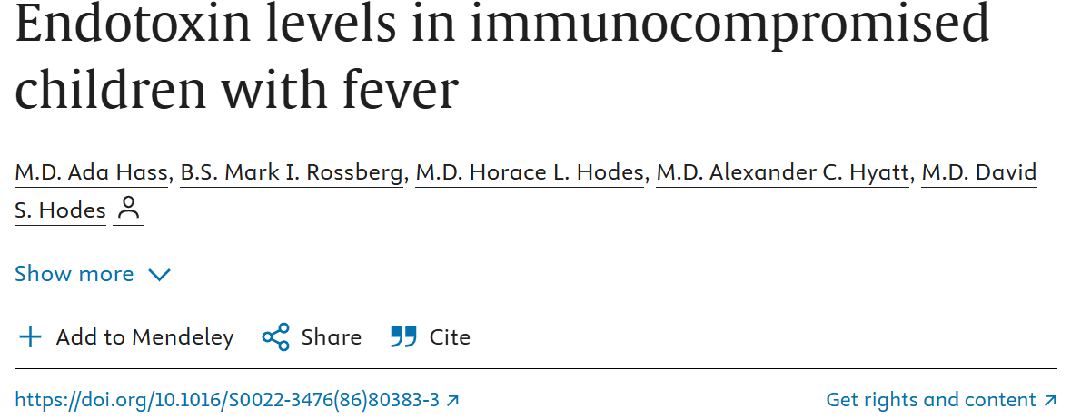
(abstract-derived information) Defined upper limit of normal endotoxin in children Plasma endotoxin levels in healthy and convalescent children were ≤35 pg/mL (0.10 EU/mL), establishing 35 pg/mL as the pediatric upper normal threshold for endotoxemia.
Endotoxemia contributes to unexplained fever without bacteremia 14% (5/36) of immunocompromised children with febrile episodes showed elevated endotoxin levels >35 pg/mL despite absence of bacteremia or clinically diagnosed infection; endotoxin levels normalized during convalescence, implicating transient endotoxemia as a potential pyrogenic mechanism in unexplained pediatric fever.

Slide 15
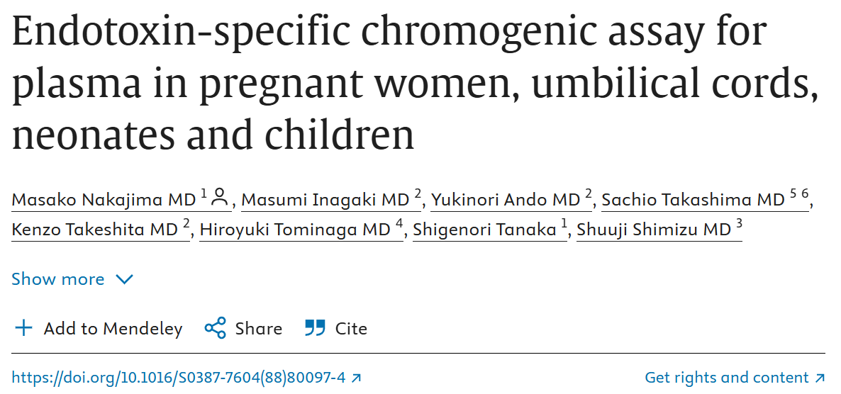
Physiological endotoxin levels are very low in normal pregnancy, neonates, and children
Using an endotoxin-specific chromogenic assay (Endospecy), endotoxin levels were 0.8 ± 0.4 pg/mL in maternal blood and 1.3 ± 0.6 pg/mL in umbilical cord blood after normal delivery; non-infectious neonates showed ~6.7 ± 5.1 pg/mL, and healthy children had levels <10 pg/mL, defining a low baseline endotoxin range in pediatric populations.

Slide 16
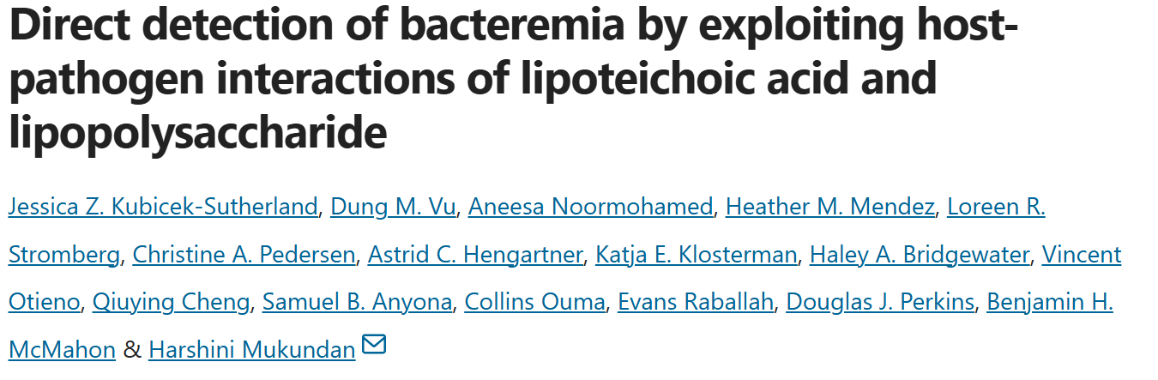
LPS and LTA are validated, pathogen-proximal biomarkers ideally suited for SERS detection
Direct detection of lipopolysaccharide (LPS) and lipoteichoic acid (LTA) captures conserved bacterial PAMPs that circulate in blood during bacteremia even at very low bacterial loads (~1 CFU/mL); this supports SERS-based, label-free detection of molecular fingerprints rather than indirect host response markers or activity-dependent endotoxin assays.

Slide 17
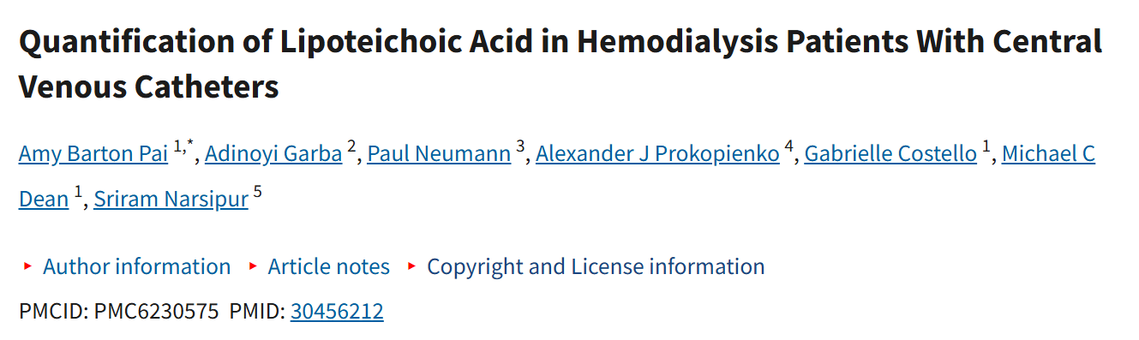
LTA is quantifiable systemically and reflects Gram-positive biofilm burden beyond culture detection
Lipoteichoic acid (LTA), a Gram-positive cell wall component, was detected in both catheter aspirate and plasma of hemodialysis patients with central venous catheters, with plasma LTA 3.93 ng/mL (0.25–15) exceeding catheter aspirate LTA 2.38 ng/mL (0.1–8.1) in 70% of patients (p = 0.01), demonstrating continuous biofilm shedding and systemic dissemination not captured by routine culture.

Slide 18
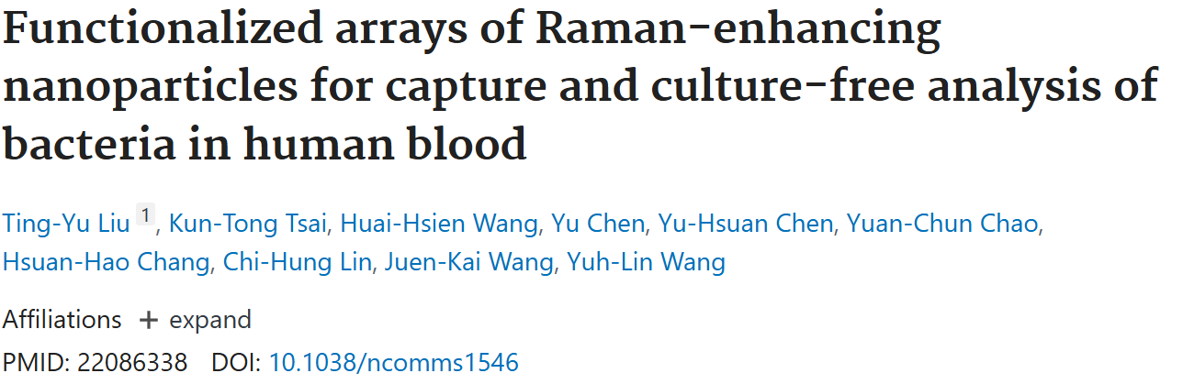
Vancomycin-functionalized SERS substrates enable culture-free capture and direct Raman detection of whole bacteria from blood Vancomycin-coated Ag nanoparticle arrays exploit specific hydrogen bonding with bacterial peptidoglycan, achieving up to ~1,000-fold enhancement in bacterial capture while excluding blood cells, enabling label-free, rapid SERS analysis directly from complex matrices like human blood.
Chemical functionalization enhances SERS sensitivity and enables phenotypic discrimination Vancomycin coating not only increases bacterial adhesion but also pulls bacterial cell walls into SERS “hot spots,” resulting in 400–500% higher Raman signal and allowing spectral differentiation between vancomycin-susceptible and resistant strains, demonstrating SERS as a powerful platform for rapid diagnostics and antimicrobial susceptibility assessment without culture.

Slide 19
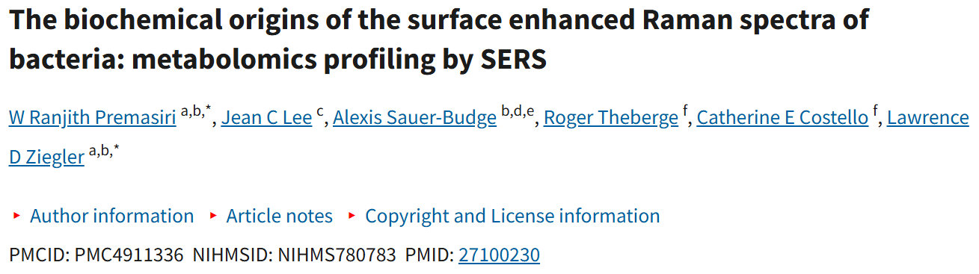
Bacterial SERS signals originate from extracellular purine metabolites, not cell-wall components At 785 nm excitation, SERS spectra of whole bacteria are dominated by purine degradation products—adenine, hypoxanthine, xanthine, guanine, uric acid, and AMP—released during starvation induced by water washing. Identical SERS fingerprints from whole cells and cell-free supernatants confirm that peptidoglycan (NAG/NAM), lipids, proteins, or LPS do not contribute significantly to these spectra.
785 nm SERS functions as a metabolic stress readout rather than a structural biomarker The bacterial SERS fingerprint reflects species-specific purine metabolism and enzyme availability, not Gram type or cell-envelope architecture. Signal intensity and composition are strongly influenced by sample preparation, washing buffer, and starvation duration, establishing SERS as a metabolic biomarker platform sensitive to bacterial stress state, rather than a direct detector of surface antigens or cell-wall molecules.

Slide 20
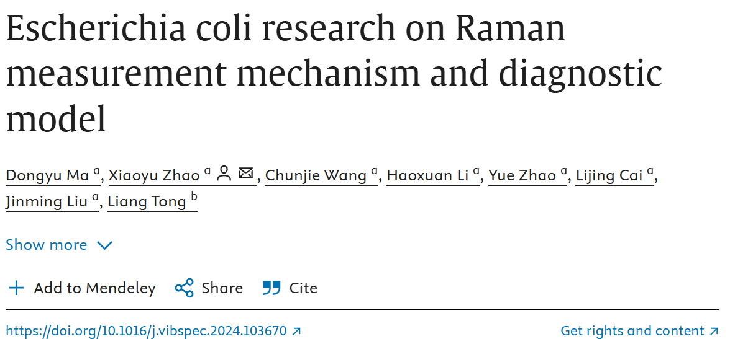
Raman/SERS signal origin is mechanistically linked to bacterial cell-wall chemistry
Raman/SERS signatures of E. coli can be physically and biologically anchored to peptidoglycan biomarkers, as Density Functional Theory (DFT)–validated vibrational modes of N-acetylmuramic acid (MurNAc) and N-acetylglucosamine (GlcNAc) directly explain the origin of diagnostic Raman bands, enabling mechanism-based interpretation rather than empirical fingerprinting.
Key Finding 2 — Mechanism-informed feature selection significantly enhances diagnostic accuracy
Incorporating DFT-certified MurNAc/GlcNAc Raman peaks (3010–3029 cm⁻¹) with chemometric selection (SPA) and machine learning (Random Forest) substantially reduces misdiagnosis and achieves near-clinical performance (~98% accuracy, AUC ≈ 1), demonstrating that biomarker-guided Raman/SERS models outperform untargeted spectral classification.

Slide 21
Comparison table for Which Solvent Has the Highest Overall Solubility?
Biomarker / Solvent | Water | PBS (pH 7.2–7.4) | DMSO | DMF | Ethanol
LTA (Staph. aureus) | 5 mg/mL (hazy) (MilliporeSigma) | Moderate (hazy; comparable to water), qualitative (MilliporeSigma) | Unknown | Unknown | Moderate (MilliporeSigma)
MurNAc | ~50 mg/mL (clear) (ChemicalBook) | ~10 mg/mL (Cayman Chemical) | ~30 mg/mL (Cayman Chemical) | ~2.5 mg/mL (Cayman Chemical) | Unknown
LPS (E. coli O111:B4) | ~5 mg/mL (hazy; up to ~20 mg/mL with heat) (MilliporeSigma) | Moderate (hazy solutions in PBS; similar to water) (MilliporeSigma) | Poor / Not reported (organic solvents do not yield clearer solutions) (MilliporeSigma) | Unknown | Poor (methanol/ethanol produce turbid suspensions with precipitates) (MilliporeSigma)

Slide 22
Best Solvent for Each Biomarker
Biomarker | Best Solvent /Highest Solubility
LTA | Water (5 mg/mL)
MurNAc | Water (~50 mg/mL)
LPS | Water (~5 mg/mL)

